Slide 1
Mr. Frog Eats
Created by Amy Basso MA, CCC/SLP

Slide 2
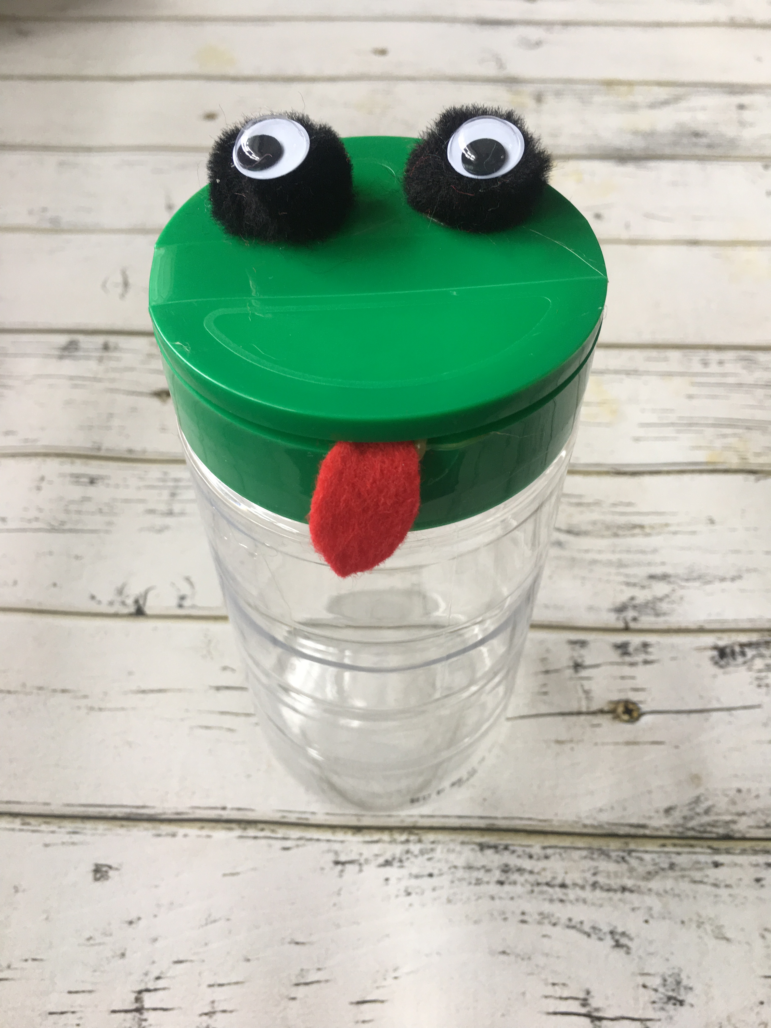
This is Mr. Frog.

Slide 3
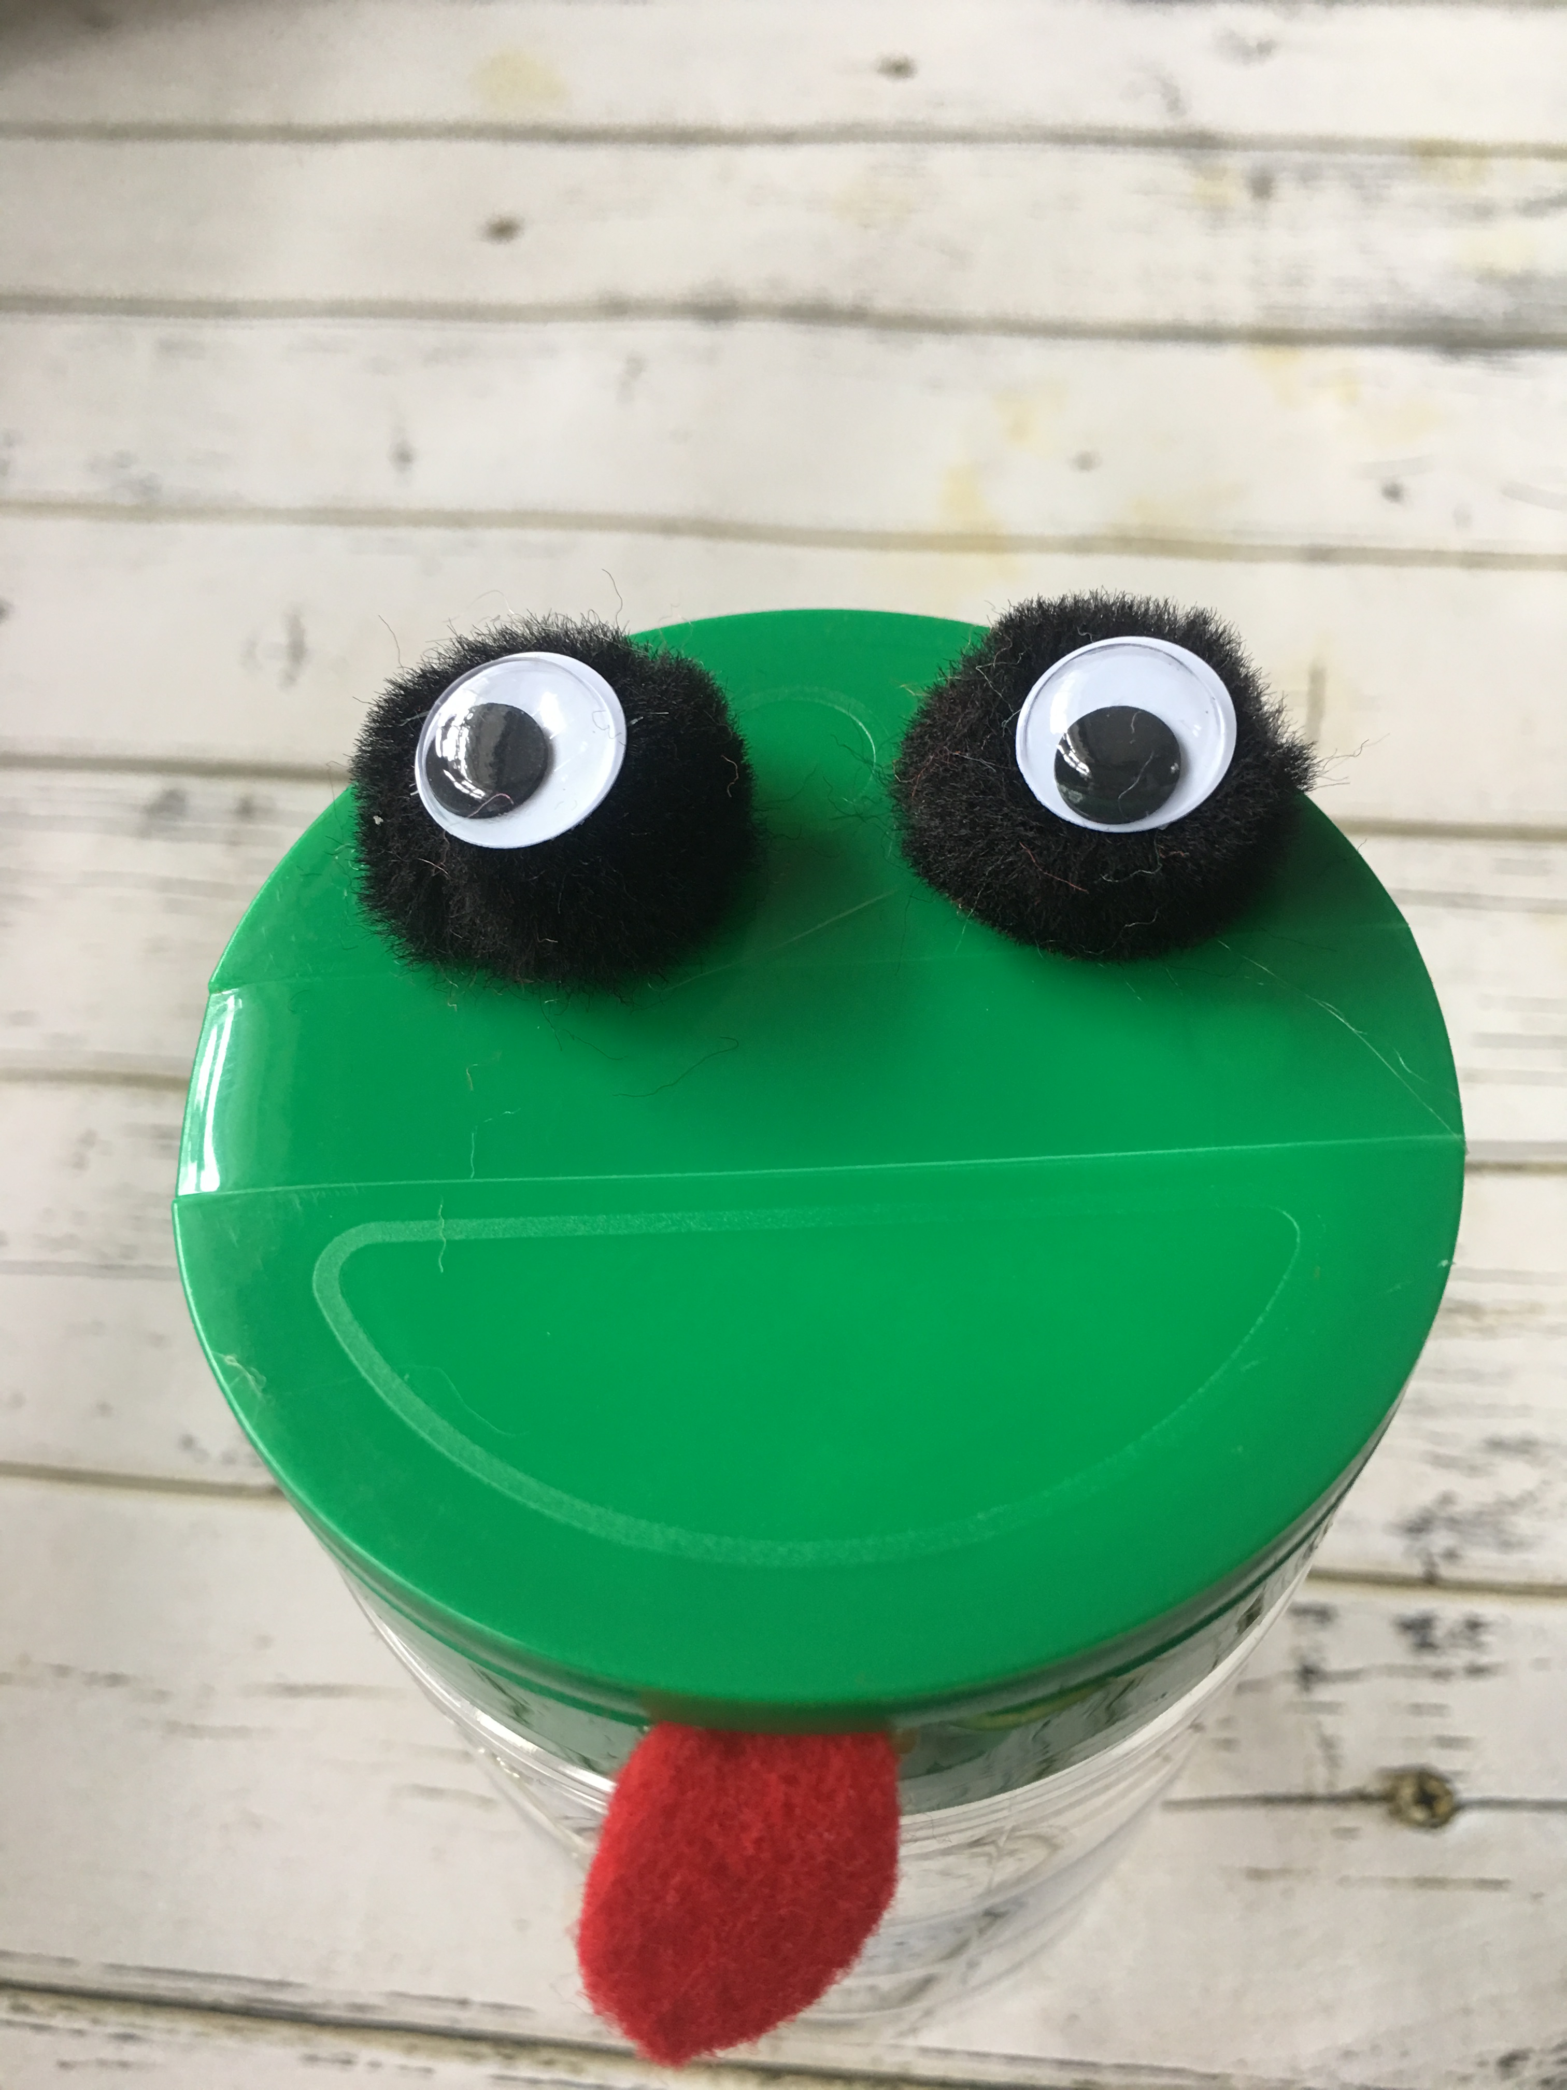
He has eyes and a mouth.

Slide 4
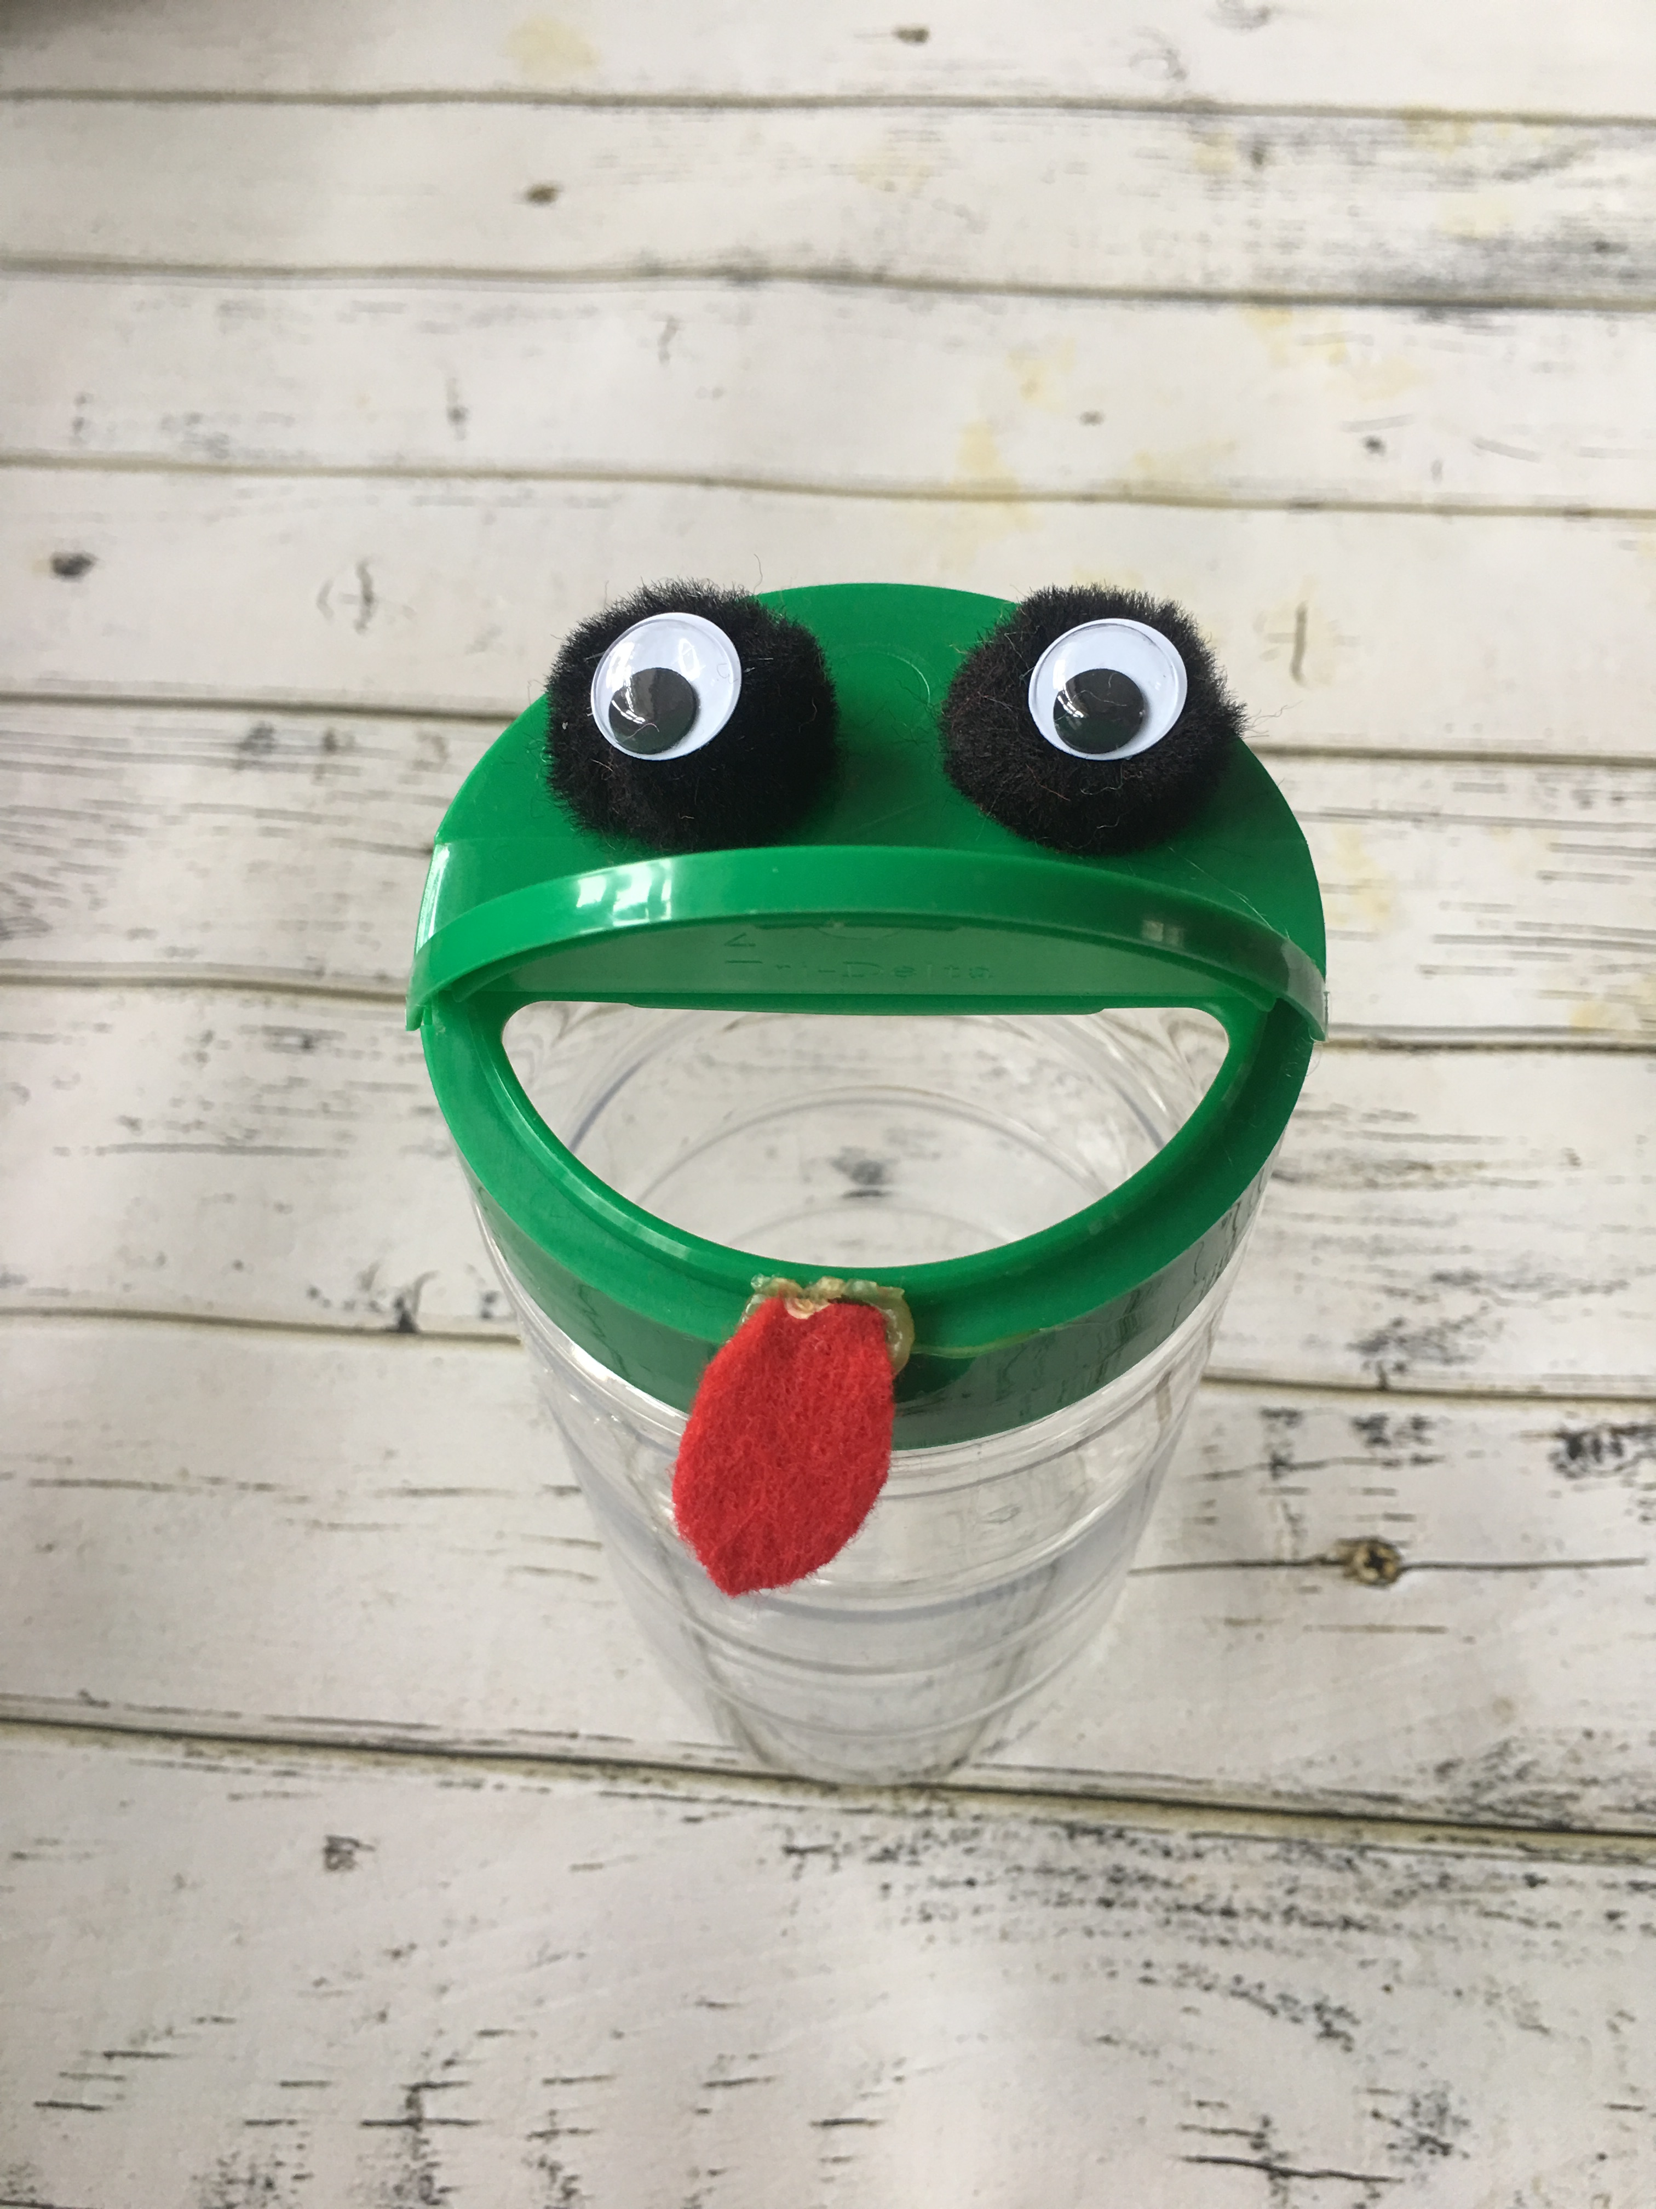
Mr. Frog can open his mouth.

Slide 5
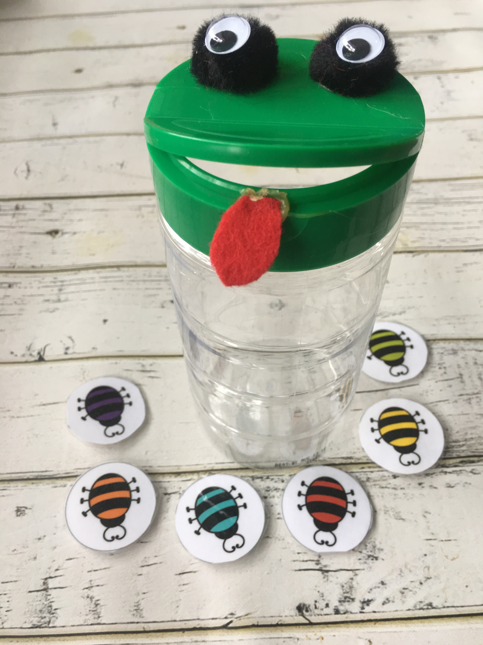
He likes to eat.

Slide 6
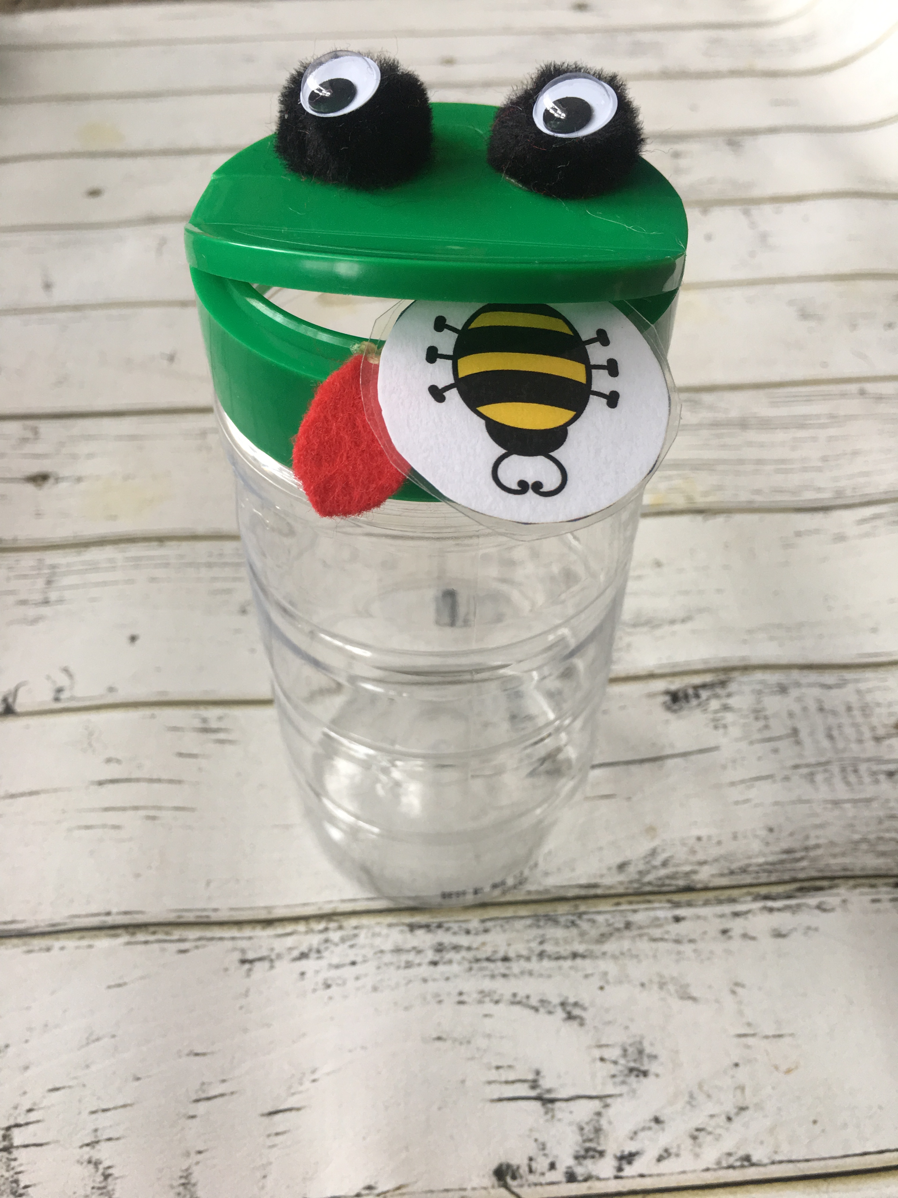
He likes to eat bugs.

Slide 7
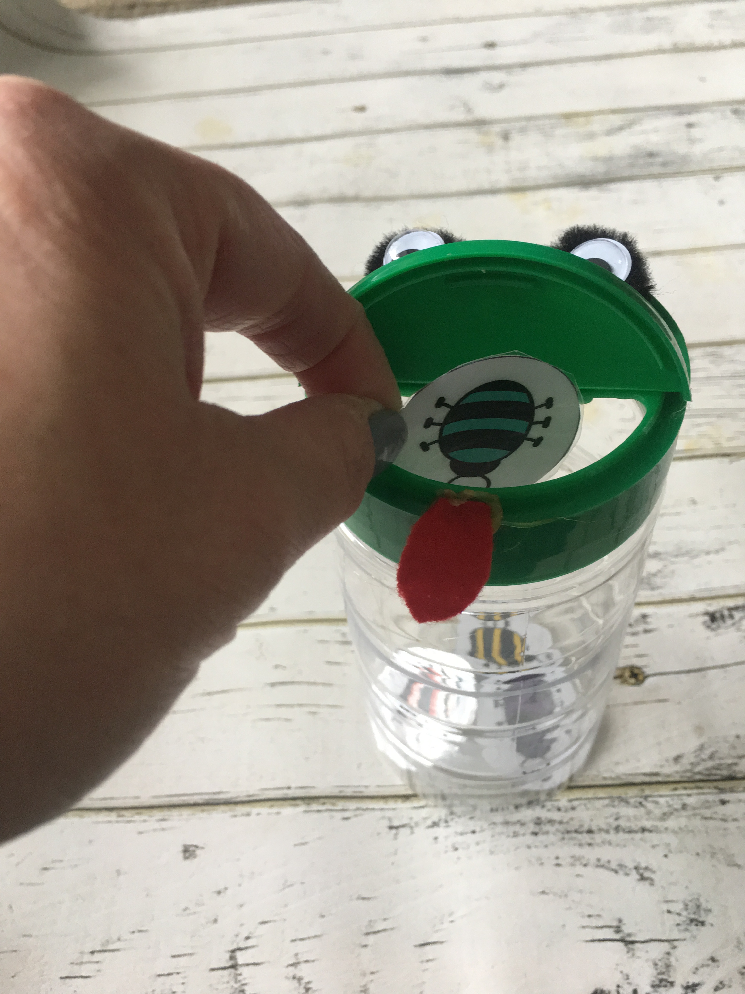
Put bugs in his mouth.

Slide 8
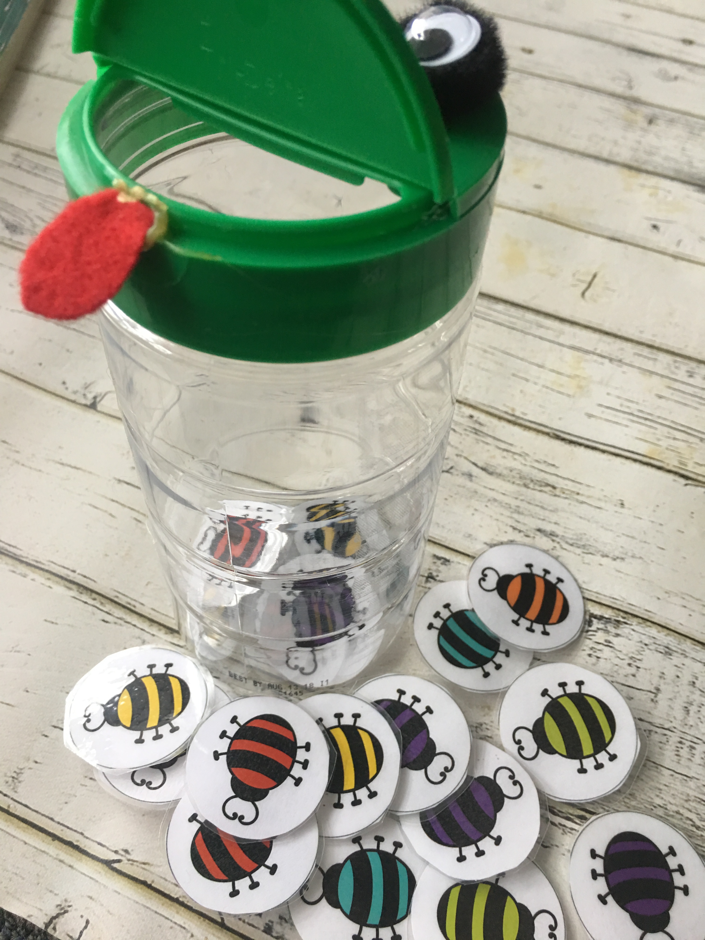
More bugs, Please!

Slide 9
The End

